Slide 1
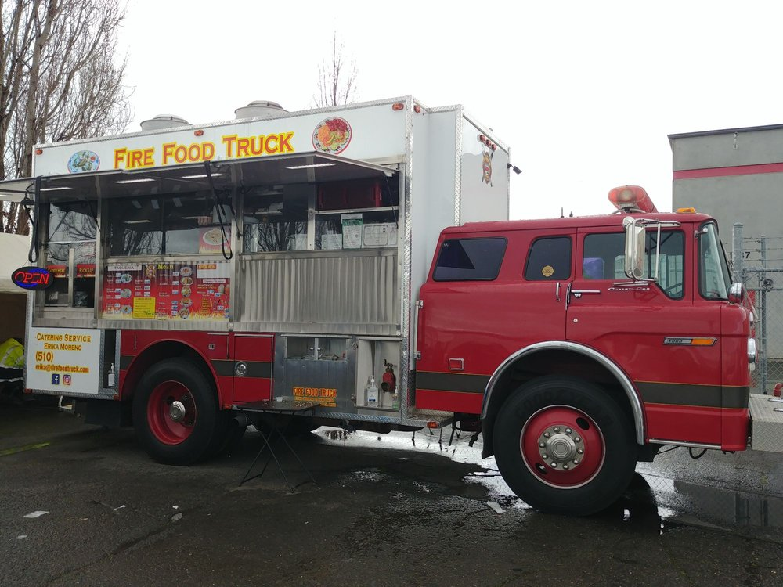
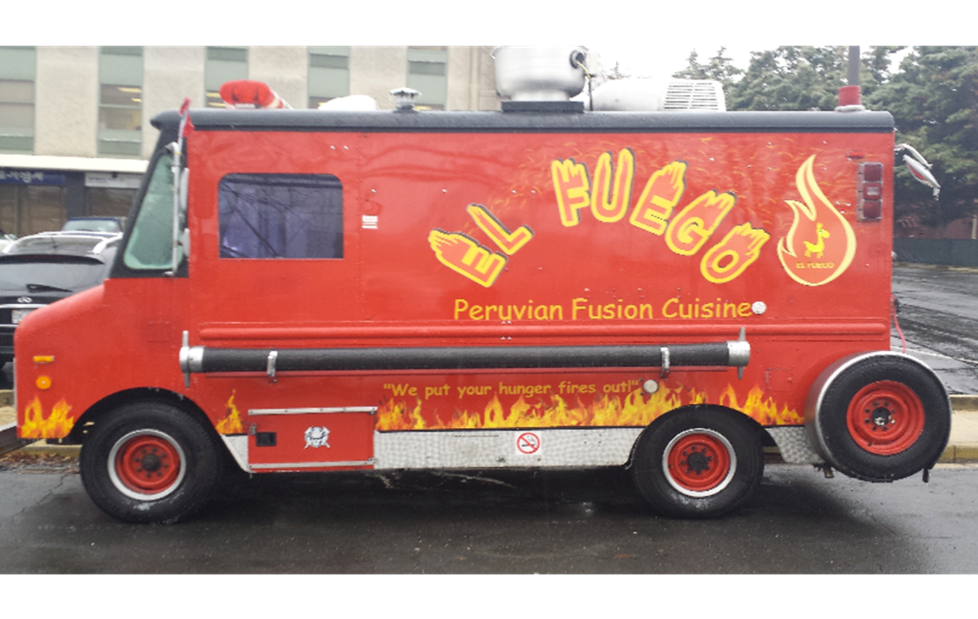
Mobile Food Vehicle
Permit and Inspection Program

Slide 2
Mobile Food Vehicle (MFV)
A GROWING INDUSTRY BRIMMING WITH FIRE HAZARDS
Posted Mar 15, 2023 by Koorsen Fire & Security
Food trucks are one of the hottest new trends in food service today.
In 2022, the value of the U.S. food truck industry increased to $1.2 billion.
Between 2011-2015, there were 21 injuries and two deaths resulting from food truck accidents in the United States. (NFPA) Last known study 2015.
As a result, NFPA has issued minimum fire safety requirements for MFV operations in the 2017 edition of NFPA 96, Standard for Ventilation Control and Fire Protection of Commercial Cooking Operations.
The fire service has begun to realize the risks associated with MFV fires and the dangers they pose to the public. Operators need to understand them, too.

Slide 3
Mobile Food Vehicle (MFV)
A GROWING INDUSTRY BRIMMING WITH FIRE HAZARDS
Posted May 16, 2018 by Koorsen Fire & Security
  Know Your Risks – 3 most Common MFV hazards.
  PROPANE is the most significant risk of fire in a MFV. According to the NFPA, about 68 percent of MFV fires are related to propane. Almost all of the incidents resulting in injuries and deaths in the past four years have been the result of propane explosions.
  GENERATORS In older converted MFV, carbon monoxide can be created by a generator that has not been properly vented or placed safely away from ignition sources.
  HOOD SUPPRESSION SYSTEMS over cooking appliances have long been required for commercial kitchens. However, hood suppression systems may be absent in MFV that have been converted into mobile kitchens.
  Additionally MFV must carry portable fire extinguishers, two types are required -- Class K extinguisher designed to suppress grease, fat or cooking oil fires, and an BC extinguisher capable of putting out fires involving flammable liquids as well energized electrical equipment.

Slide 4
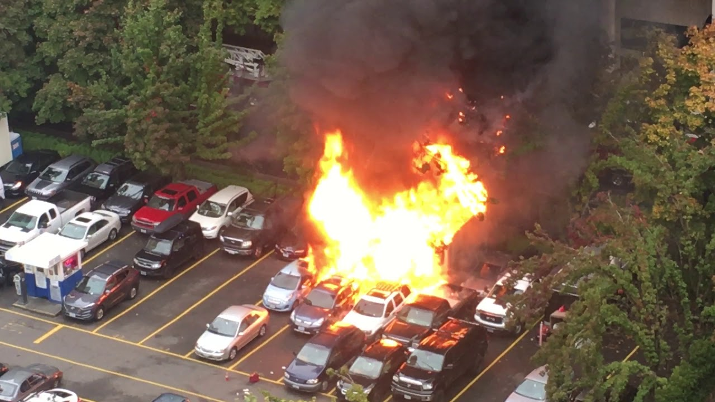
Portland Oregon Food Cart Fire
https://youtu.be/FkVKnAn60ss

Slide 5
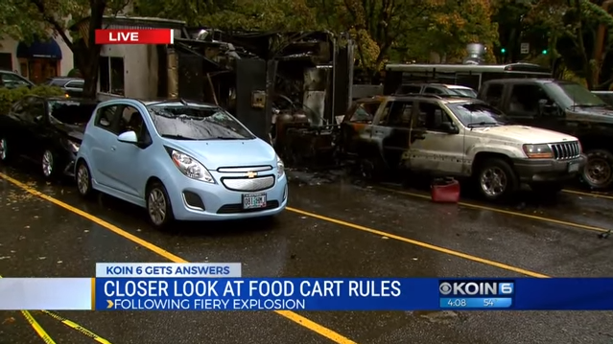
Portland Oregon Food Cart Fire
https://youtu.be/Pc-jS-BXFq8

Slide 6
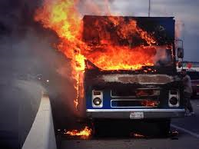
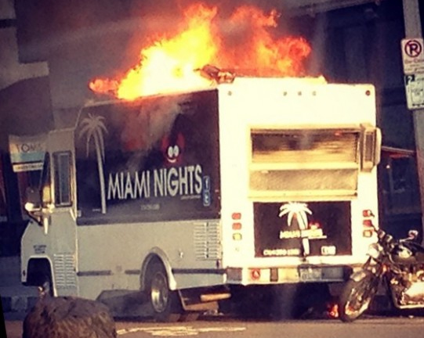
Mobile Food Vehicle Fire

Slide 7
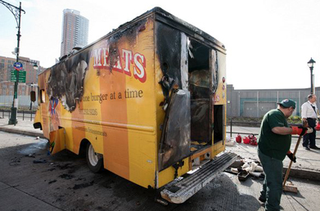
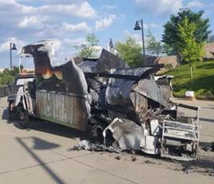
Mobile Food Vehicle Fire

Slide 8
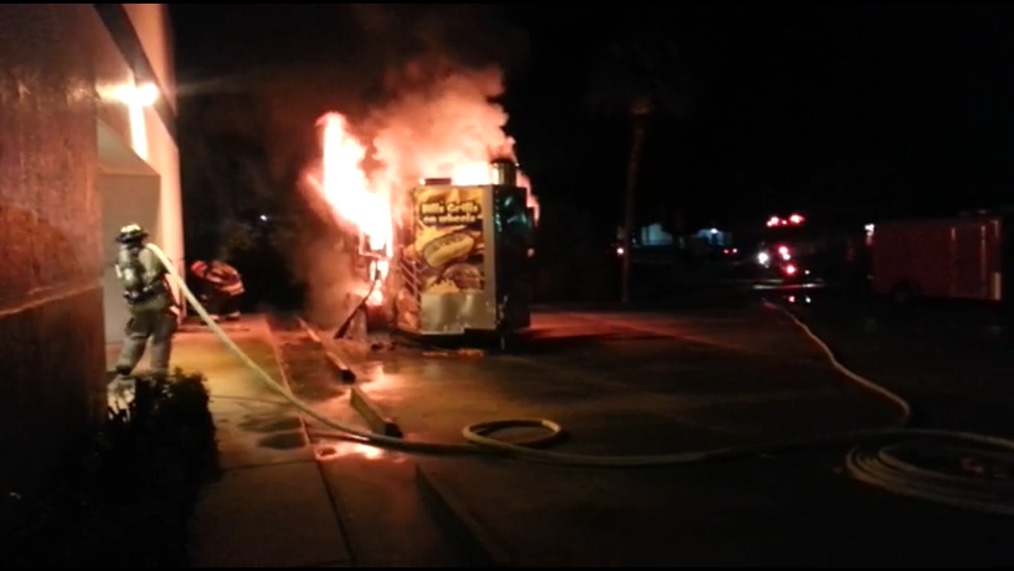
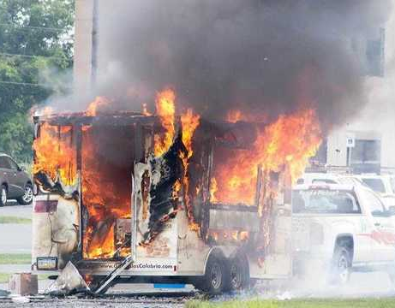
Mobile Food Trailer Fires
Notes:
Separation between all Mobile Food Vehicles other MFV’s and Buildings shall be maintained no less than 10 feet

Slide 9
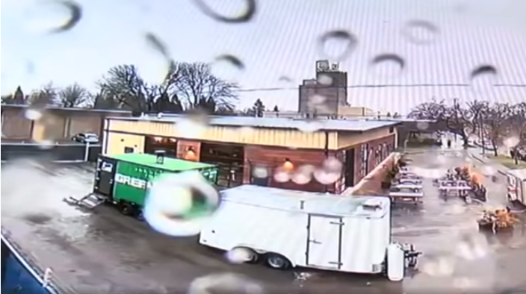
Mobile Food Trailer LPG Explosion
https://youtu.be/ImYzIVW2j8I

Slide 10

Preventative Maintenance
Ordinance holds Vendors liable for cost of damage to public property as a result of their operation.
Failure to maintain your vehicle motor can impact you financially.
Check for fluid levels, and leaks daily, before the start of your operations. Maintain your tires, batteries, and belts
Ordinance prohibits dumping Gray water into city sewer drains or waterways.
Wheel Chocks are required for trucks and concession trailers

Slide 11
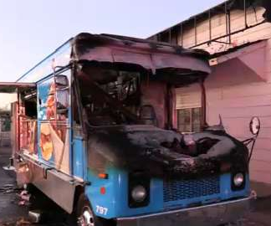
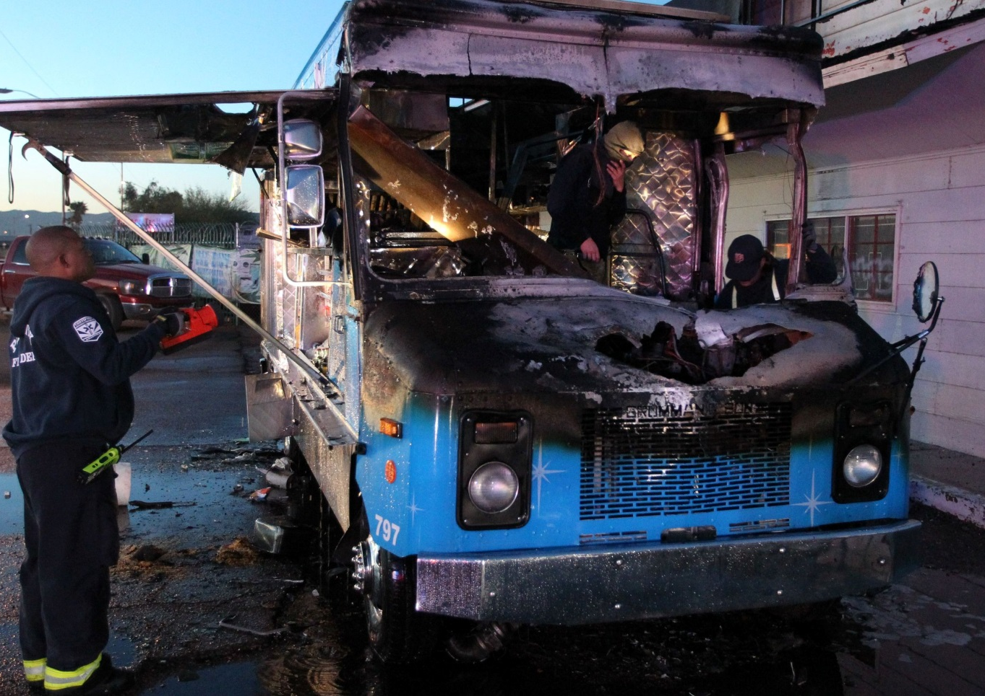
Mobile Food Vehicle engine compartment Fire
Notes:
Fire appears to have originated in engine compartment

Slide 12
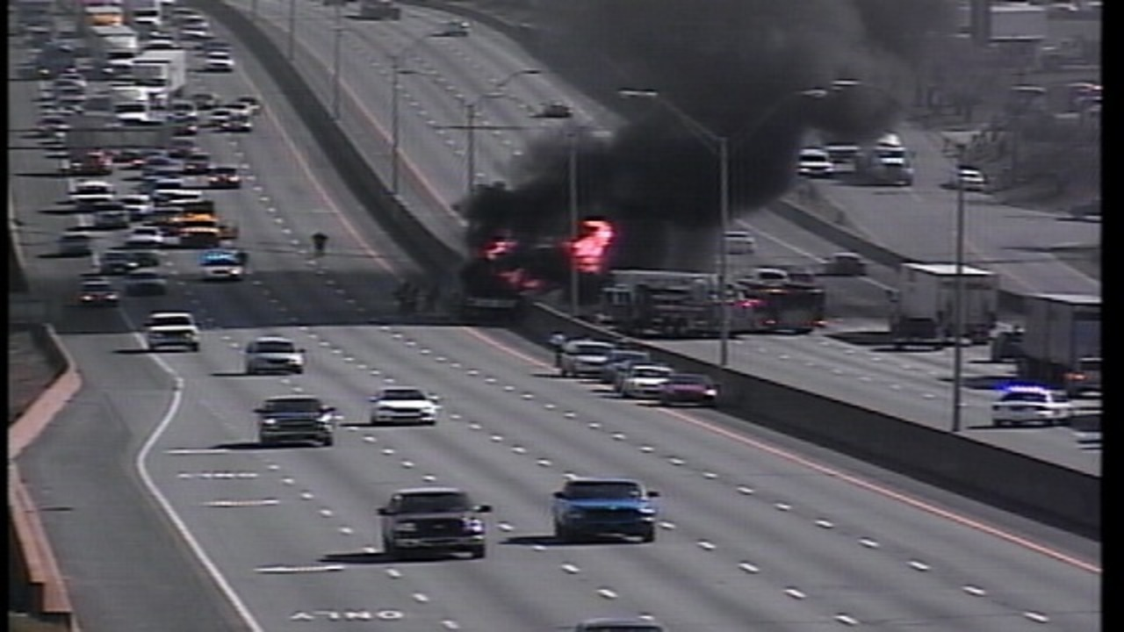
Mobile Food Vehicle Fire I-85
https://youtu.be/VLofN44Nsic
Notes:
Make sure all systems are in the “Off” position and LPG tanks are shut off too.

Slide 13
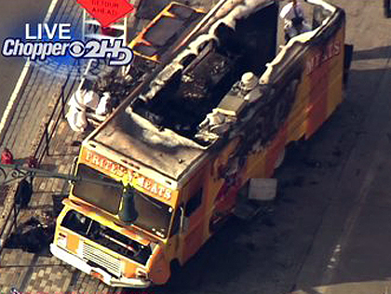
MFV Fire 1-85 Extinguished

Slide 14
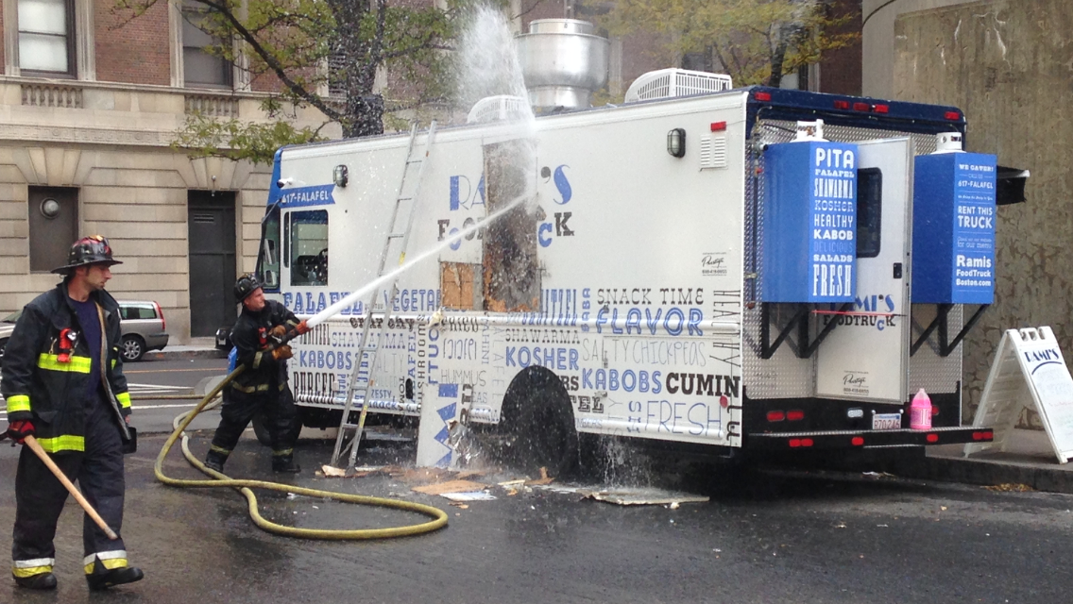
MFV –Extinguishment in Progress
Notes:
Quick action by Hood system made a difference. Fire crew is performing overhaul –easily repaired quicker turn around time for resuming operations.

Slide 15
MFV –Extinguishment in Progress
Notes:
Quick action by Hood system made a difference. Fire crew is performing overhaul –easily repaired quicker turn around time for resuming operations.

Slide 16
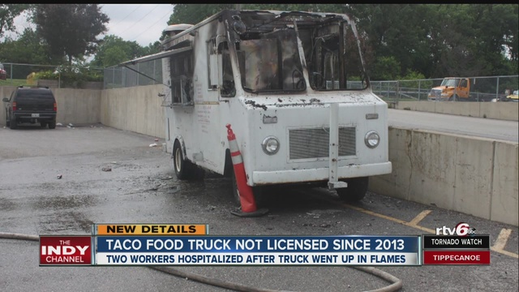
The need for Inspections
https://youtu.be/DLCbvRhi0xA

Slide 17
Inspections
Inspection authority comes from International Fire Code (IFC) as well as NFPA by reference.
Venders are required to be compliant with IFC/NFPA Codes
NFPA 58 sets requirements for storage, use and transport of LPG/Propane
Commercial Food Operations also includes the Michigan Mechanical Code.
These Codes reference and utilize the National Fire Protection Association, also known as the National Fire Code.
For MFV inspections we will concentrate on Cooking Operations, Automatic Fire Suppression, Fire extinguishers, Liquefied Petroleum Gas or Fuel sources, Generators, Egress, and General Fire Safety.

Slide 18
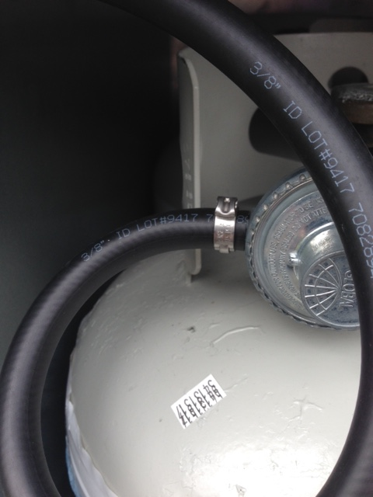
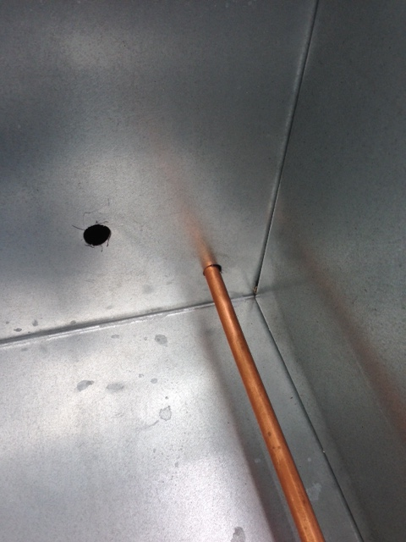
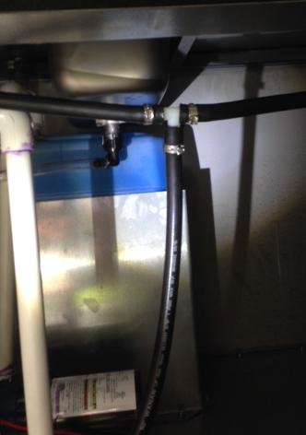
Significant Findings contrary to Safe Ops
No clamps on gas, factory
fit only
Gas lines through bulkheads require black pipe
improper gas connections “T” is a water line connector
Notes:
No: clamps on gas-factory fit only, Gas lines through bulkheads require black pipe, No improper gas connections – “T” was actually a water line connector.

Slide 19
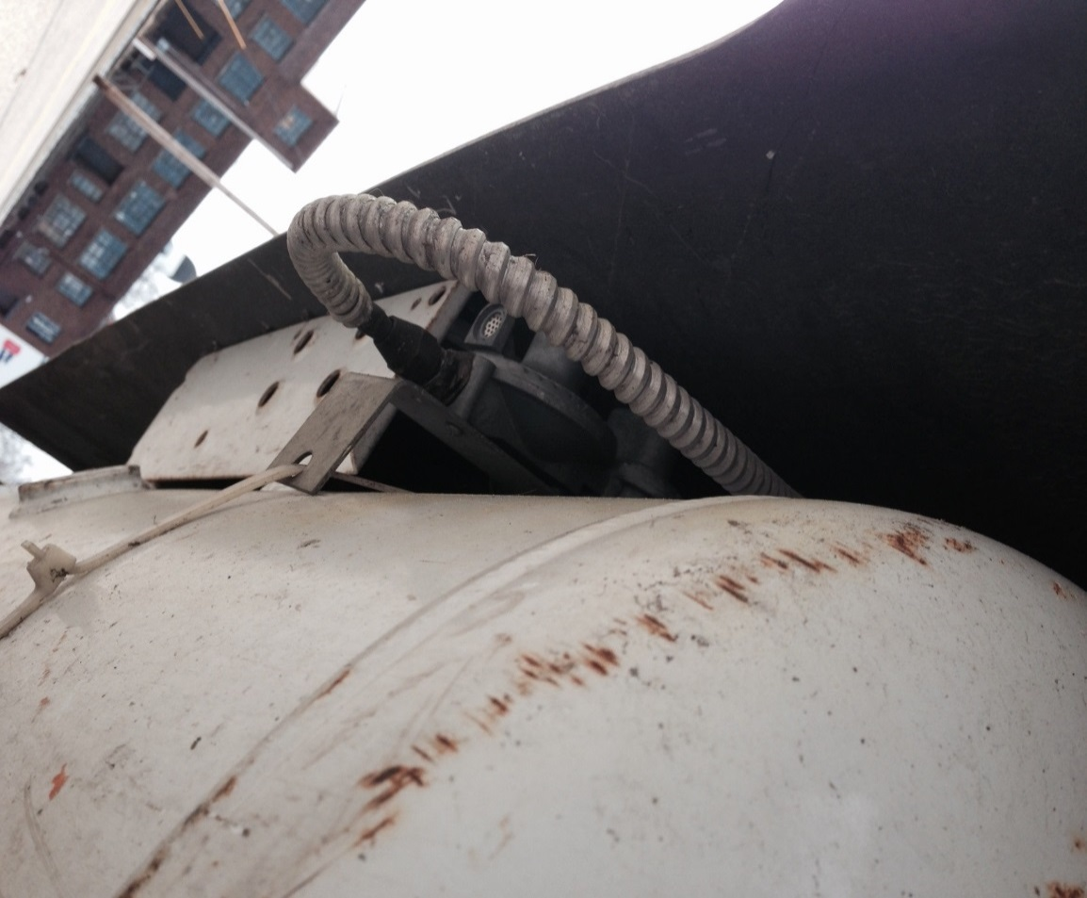
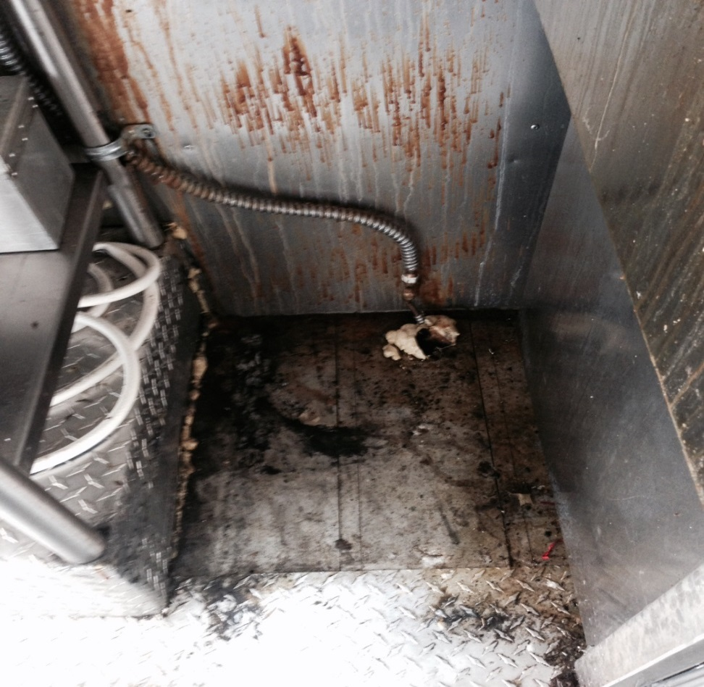
Significant Findings contrary to Safe Ops
Cobbled LPG line through bulkhead, this is copper tubing “protected” by electric flex conduit – IMPROPER and dangerous
Notes:
Cobbled LPG line through bulkhead, this is copper tubing “protected” by electric flex conduit – IMPROPER and dangerous

Slide 20
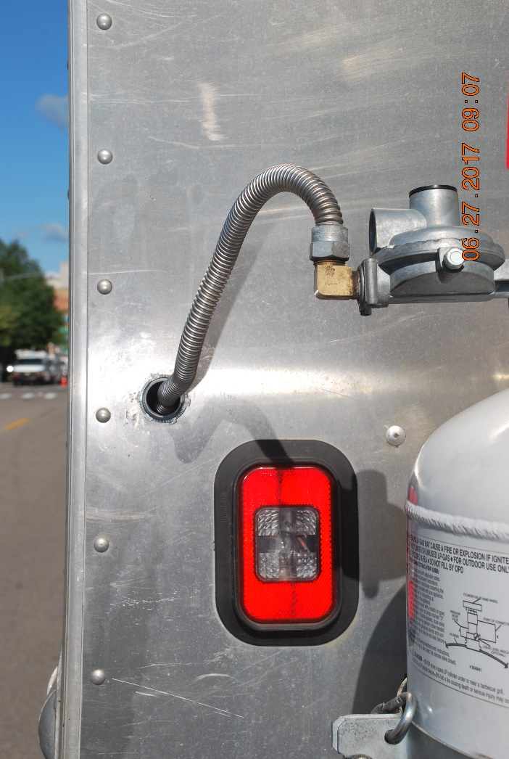
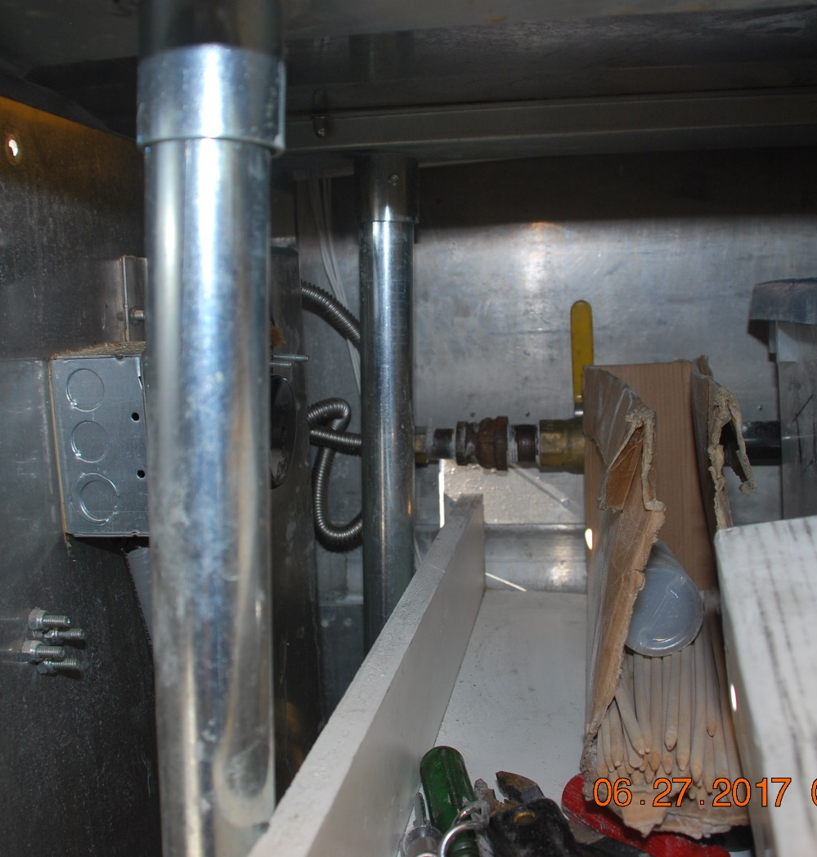
Significant Finding contrary to safe ops

Slide 21
Mobile Food Vehicle Cooking Operations
Mobile Food Vehicles may use one or more of the following based on their operations:
  Liquefied Petroleum Gas (LPG)
  Deep Fryer Oil
  Grills with Open flame
  Compressed Natural Gas (CNG)
  Electricity – shore line
  Remote and built in generators

Slide 22
Cooking Operations
IFC Section 609: Commercial Kitchen Hoods shall comply with the International Mechanical Code / Michigan Mechanical Code. Type 1 hoods shall be installed at or above all commercial cooking appliances and domestic cooking appliances used for commercial purposes that produce grease vapors. Type II for others.
Systems are subject to cleaning and inspection by a Service Contractor every 6 months. –IFC 609.3.3.1
Exterior Fuel Shut offs locations are required to be marked with reflective material no less than 2” lettering
Baffles required between Deep Fryers and surface flames of adjacent cooking equipment.

Slide 23
Hoods
All Mobile Food Vehicles, including trailers, with operations that produce grease laden vapors shall have a Hood with an installed fire suppression system. (Type 1) Systems shall be designed to automatically shut of the fuel supply. Systems are required to have a manual pull station.
Fire Suppression systems shall be inspected annually by a certified fire service contractor.
All Mobile Food Vehicles, including trailers, with operations requiring a Hood (Type 1 or 2) shall be inspected semi-annually by a fire service contractor. –Exception made for Seasonal Operations-

Slide 24
Automatic Fire Suppression System
Automatic Suppression Systems (Type 1 Hood) IFC Section 904 must be approved and installed in accordance with this code. System shall be tested in accordance with UL 300, listed and labeled.
This requires system interlocking with automatic fuel shut off and ventilation control system.
Must also include manual activation device (Handpull). Manual handpull should be located at/near point of egress.
System shall be inspected, tagged and certified annually.

Slide 25
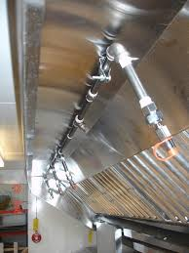
Automatic Fire Suppression System

Slide 26
Automatic Fire Suppression System
https://youtu.be/I-_SVsJvcUU
Notes:
Nozzles are capped and in the correct position- note inspection tag on manual pull handle

Slide 27
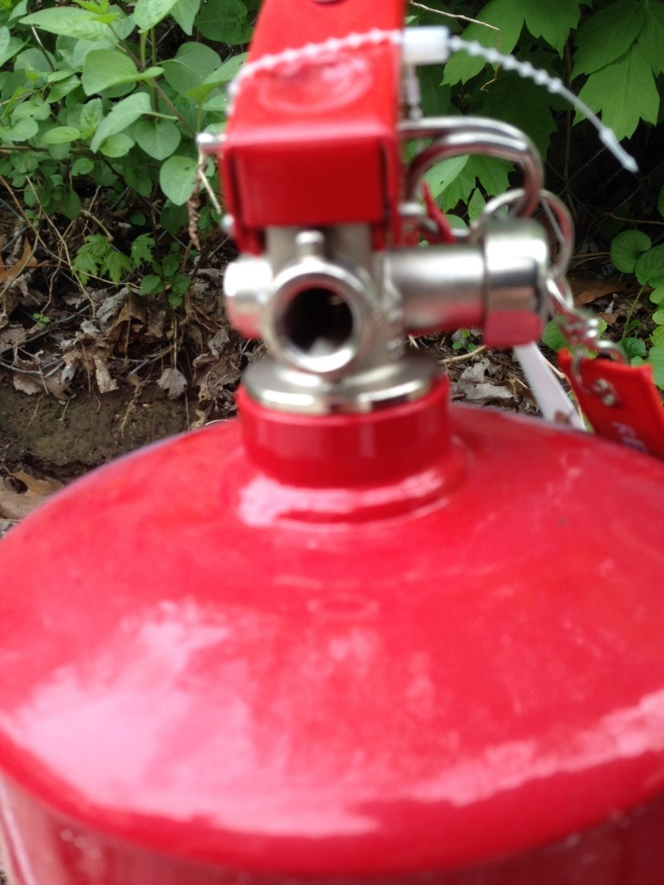
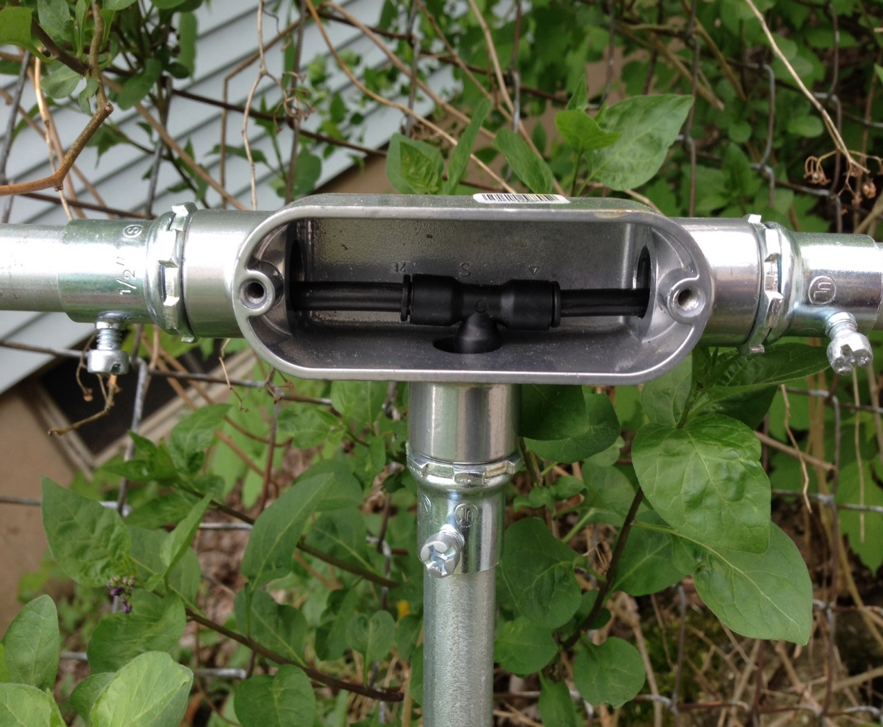
Significant Finding contrary to safe ops
Notes:
Internet buy of the week – Cobbled extinguishing system, had to be replaced at operators expense.

Slide 28
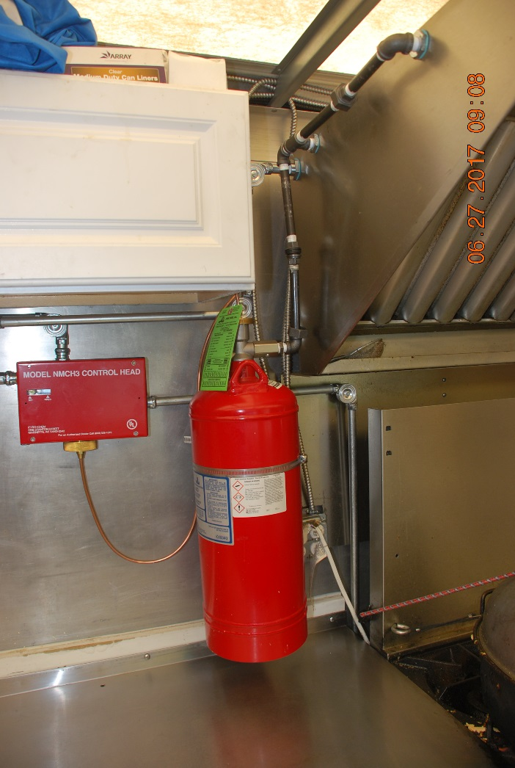
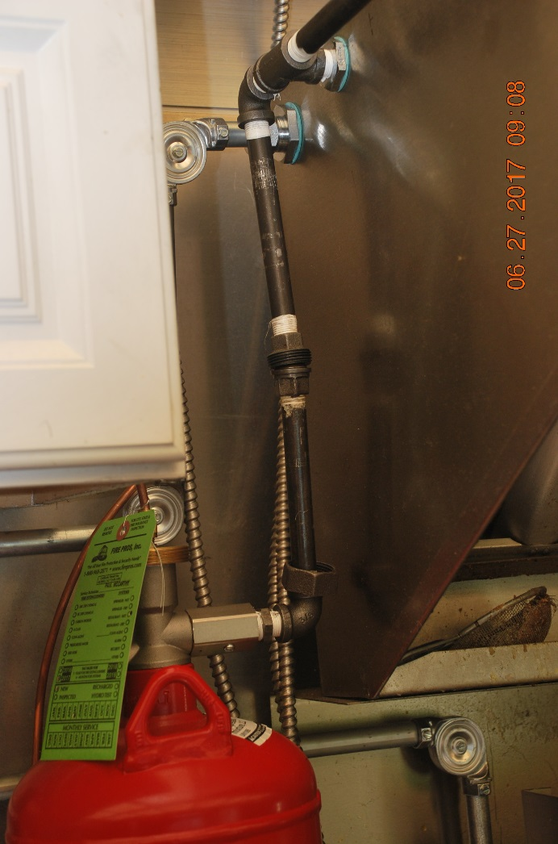
Significant Finding contrary to safe ops
Fire Service Contractor failed to reconnect the pipe union post inspection. This contractor instillation error was discovered by inspectors.
Notes:
Fire Service Contractor failed to reconnect the pipe union post inspection. This error was caught by one of our inspectors.

Slide 29
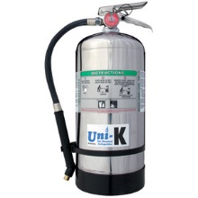
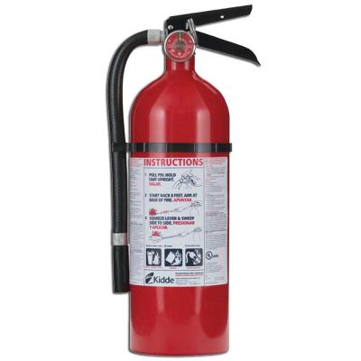
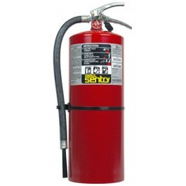
Fire Extinguishers
Handheld fire extinguishers are required commensurate with the type of operation you are engaged in. Also, required to be inspected, tagged and certified annually.
Class K
2A20BC
3A40BC

Slide 30
Fire Extinguishers
Extinguisher Types
Class A- Water Can: Ordinary combustibles, Wood, Paper , natural fibers.
Class BC- CO2/Dry Chemical Combustible/Flammable Liquids
Multi-Purpose Dry Chemical ABC-Ordinary combustibles, Flammable Liquids, Electrical
Class D- Metal
Class K- Kitchen cooking fluids (oil and fat)
Extinguishers shall be tagged/certified annually.

Slide 31
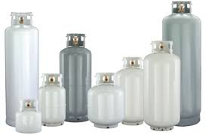
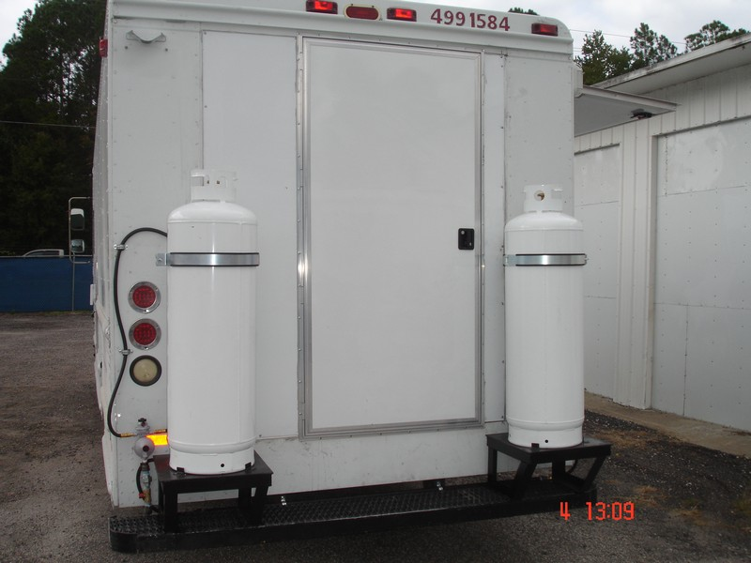
Fuel Systems –LPG/Propane

Slide 32
Fuel Systems –LPG/Propane
Requires inspection and compliance with IFC Chapter 61, NFPA 58
Tanks not built to ATSM requirement, not permanently mounted require Hydrostatic Testing. (every 3 years)
Relief valves shall be in direct communication with vapor space.
Tanks that are venting (puffing), may be a sign of issue, and require service. They are to be removed from the vehicle, immediately.
Hoses and piping must be UL or FM listed and marked to 350 psi working pressure.
Located outside of vehicle, secured with chain and/or mounting bracket. Prevent movement, shifting or rotating.

Slide 33
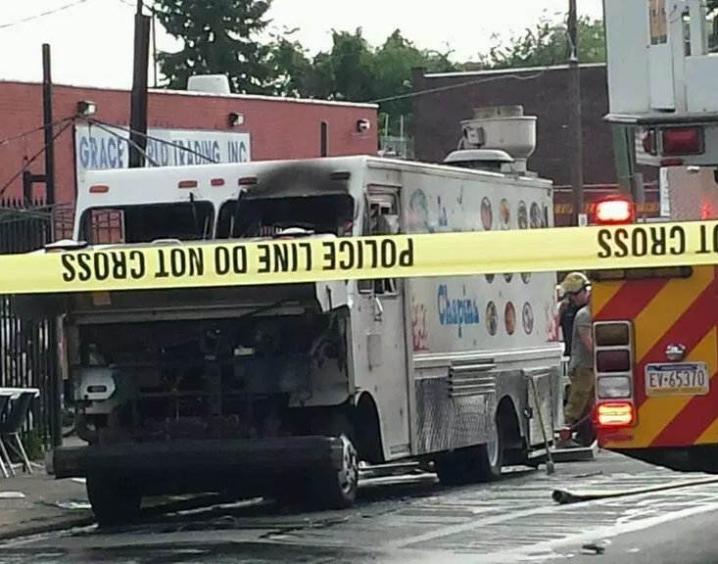
Philadelphia Food Truck Explosion
July 1st, 2014, Philadelphia Pennsylvania, At Third and Wyoming streets.
High temperature 93 degrees.
propane tank aboard “La Paradilla Chapina” explodes with workers inside as a result of a faulty and improperly filled Propane tank.
The Explosion killed Olga Galdamez and her 17-year-old daughter, Jaylin. The blast also injured nearly a dozen others.
U-Haul fined $1 million, The company will pay a combined $160 million to two people who were badly injured, as well as Galdamez’ family.
The settlement is the largest pretrial settlement in Pennsylvania state court history.

Slide 34
Philadelphia Food Truck Explosion
https://youtu.be/fBv5eFyJiwA

Slide 35
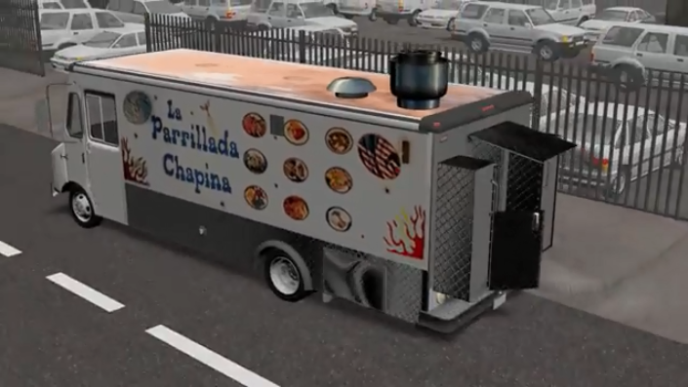
Philadelphia Food Truck Explosion
https://youtu.be/1YLLfOreaVE

Slide 36
Philadelphia Food Truck Explosion
https://youtu.be/yDr_8kqmxLM

Slide 37
Food truck blast raises safety questions
https://youtu.be/VrI1J5b485M

Slide 38
Compressed Gas Fuel Systems
LPG/Propane or CNG. Tank sizes vary, but it is common to find multiple tanks in use. 200 lbs aggregate Max Allowable Quantity.
Shall have a LPG/CNG GAS Detector inside of MFV.
All tanks are subject to US-DOT inspection requirements. Must be within their hydrostatic test/external examination dates
Tanks shall be secured with mounting brackets or chains. Bungee cords are not a viable means of security. Relief valves shall be in operating order and in line with the vapor space and vented to the atmosphere.
Requires remote “SHUT OFF” via ¼ turn valve with reflective 4” lettering signage.
Requires “NO SMOKING” marking, reflective 2” lettering.

Slide 39
Fuel Shutoffs
Pressure release valves pointed away from doors
All Knobs on appliances shall be in place and functioning.
Automatic / Integrated fuel shutoffs required for Type I hoods
Manual shutoffs at appliance
Main Shutoffs at source - Cylinder Must be marked!

Slide 40
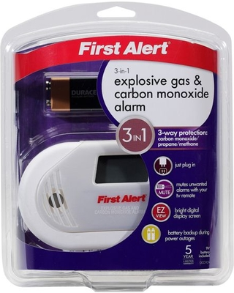
Explosive Gas Detector Alarm

Slide 41
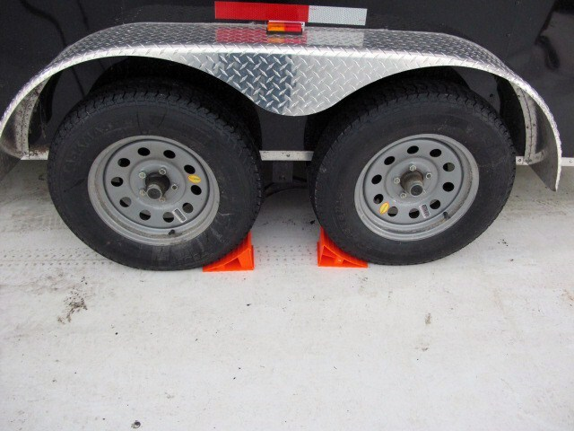
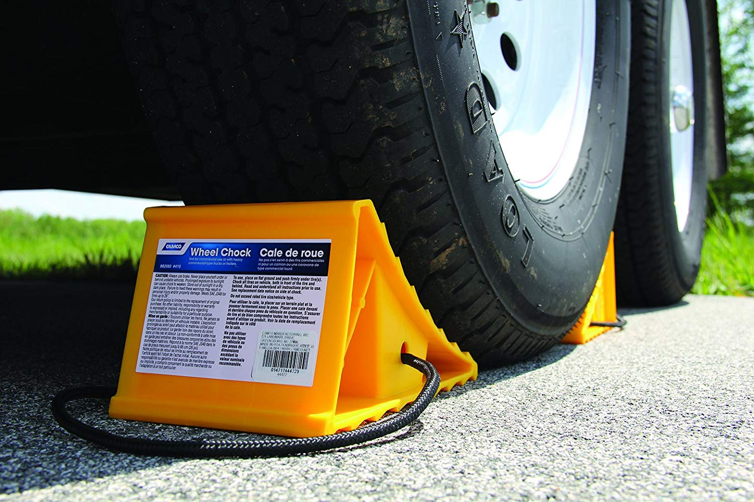
Wheel Chocks

Slide 42
Generator Operations
Ordinance Noise Requirements All generators must operate at a level of 80 decibels or lower when measure from a distance of 15 feet. Initial Inspection by the fire department will include generator noise testing.
All Mobile Food Businesses shall direct exhaust away from the service side of the vehicle.
Refueling: Make sure your generator is filled prior to opening for the day. If you must refuel, shutoff your generator allow 20 minutes to cool off, separate from other ignition sources.
Gasoline must be metal safety cans, and stored away from operations.

Slide 43
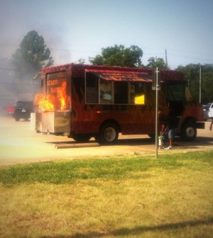
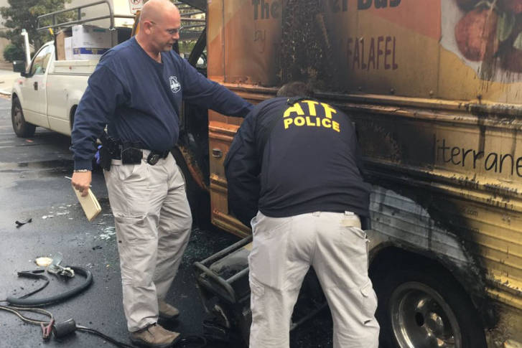
Generator Fires
Notes:
Operator attempted to extinguish this fire, do not risk putting yourself in harms way. Gasoline tank could rupture and set you on fire.

Slide 44
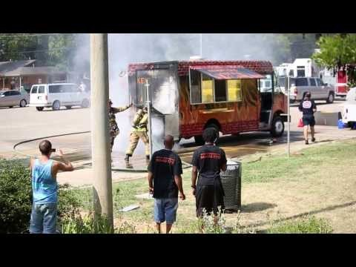
Generator Fires
https://youtu.be/ajMos9yVzMo
Notes:
Fire Attack crew requires space to move for extinguishment – 10 feet is a minimum.

Slide 45
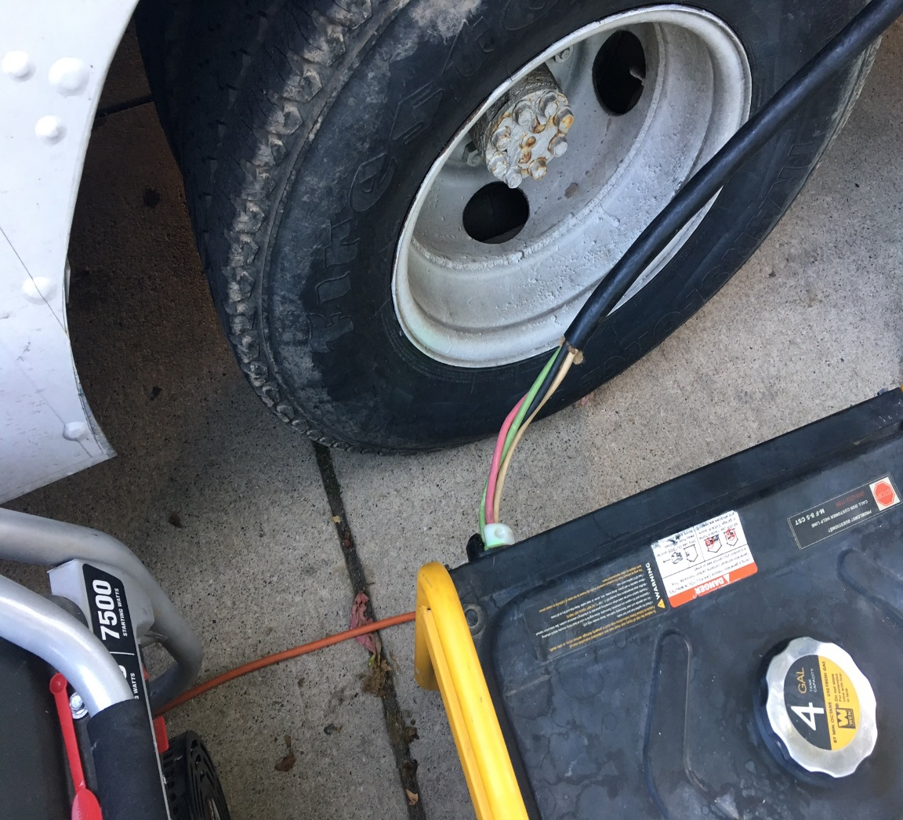
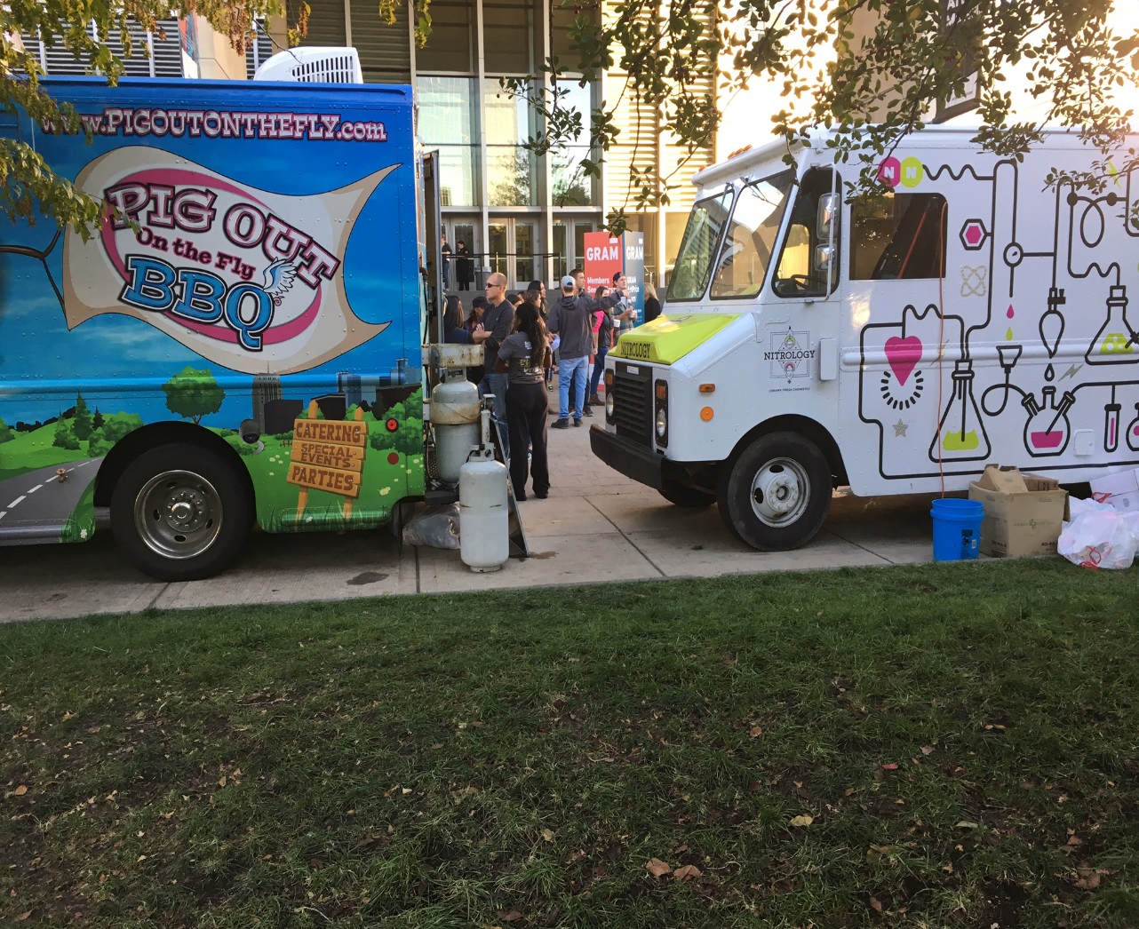
Significant Findings contrary to safe ops

Slide 46
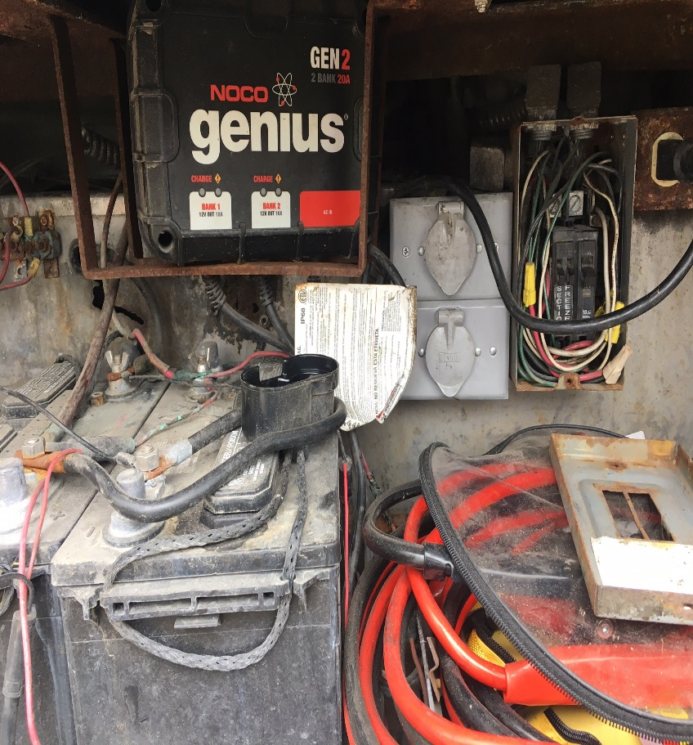
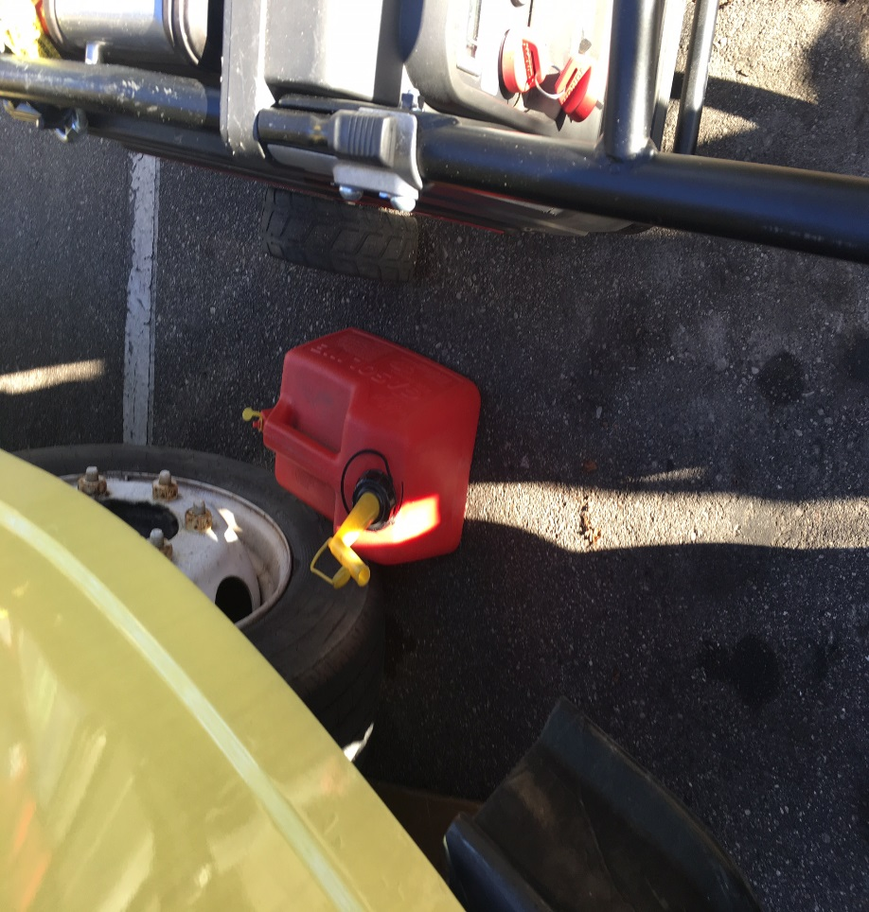
Significant Findings contrary to safe ops
Improper electrical and improper gas can with proximity issue to ignition source
Notes:
Improper electrical and improper gas can with proximity issue to ignition source -

Slide 47
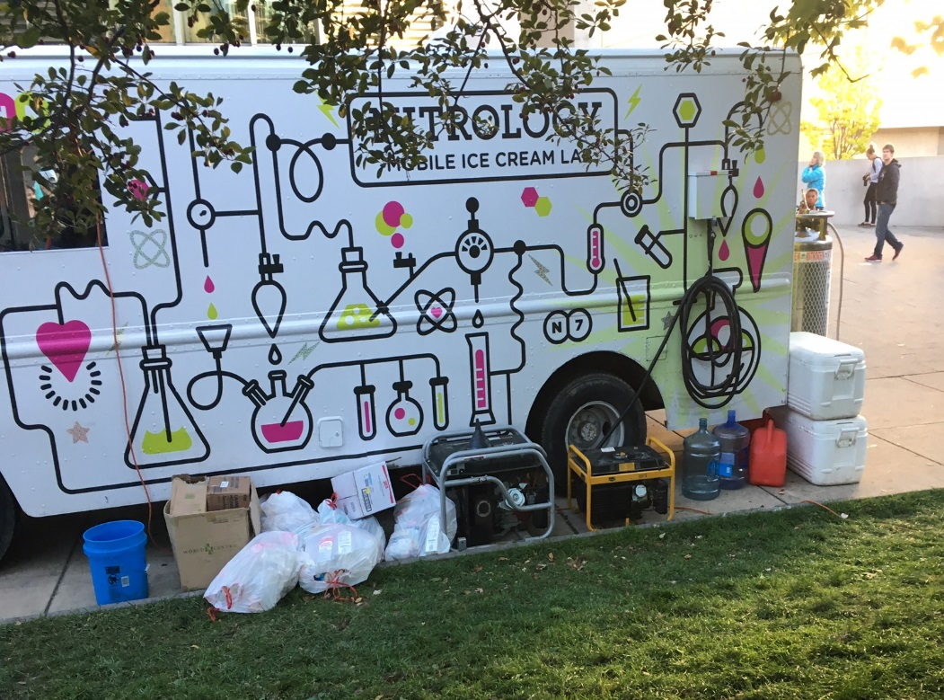
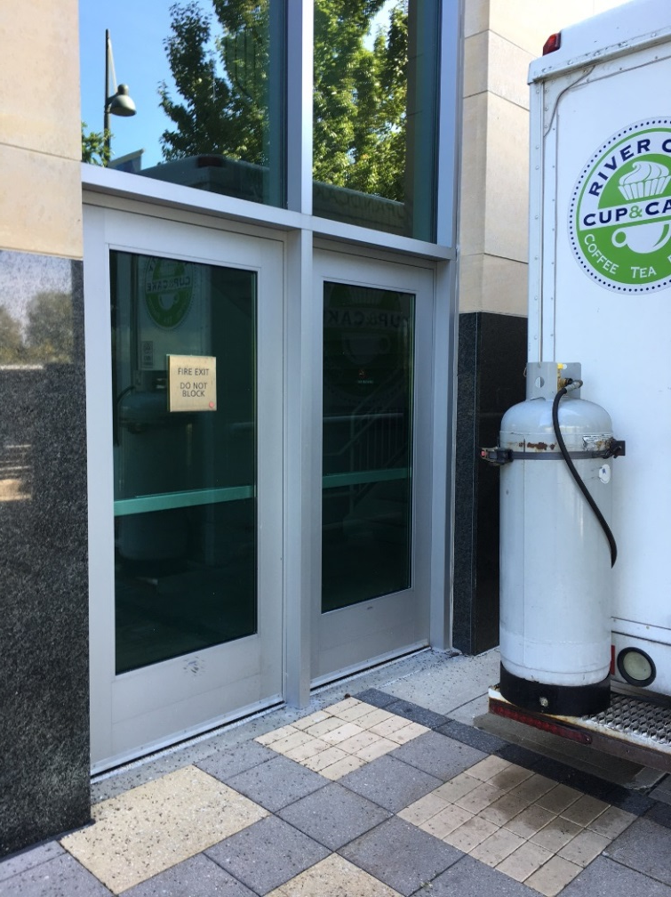
Significant Findings contrary to safe ops
MFV parked Too close to building & improper gas can, trash accumulation, and proximity to running generator –ignition source
Notes:
Too close to building –improper gas can, trash accumulation, and proximity to running generator –ignition source

Slide 48
Power Systems
Shore lines/Extension Cords shall be plugged directly into an approved receptacle, except for approved multi plug extension cords. No Pigtails, splicing or “daisy chaining”. Cords shall not be less than the required ampheres of the appliance supplied.
Cords shall be in good condition without splices, deterioration or damage. Must be protected from physical damage or becoming a trip hazard.
All connections must be weather tight from rain/snow/water. No household power cords or electrical outlets permitted.
All wiring shall be in compliance with the NEC.

Slide 49
Means of Egress
Getting out of a food truck during an emergency is CRITICAL!
Doors must function 100%. This includes latches and handles.
Keep your pathway clear, and clean. Blocking, tripping and slipping will hamper your escape.
Storage should not be kept in travel areas. It should also be stored securely..
Make sure your exit and path away from the vehicle is not blocked or narrowed. This includes inside and outside of vehicle.

Slide 50
Means of Egress
Doors must be clear for exit. Hardware must be in good repair.
Exits must be marked with reflective 2” signage.
Operations in trucks greater than 10 feet may require 2 means of exiting. means of egress with a travel distance not to exceed 10’
74” floor to ceiling Clear unobstructed over the aisle way
Minimum width of 30” of unobstructed aisle Space
Train your employees on EXITING

Slide 51
Fire Class 101
Fire- A rapid oxidation process, which is a chemical reaction resulting in the evolution of light and heat in varying intensities…
Types of Fires
  Class A- Ordinary combustibles, Wood, Paper , natural fibers.
  Class B- Combustible/Flammable Liquids
  Class C- Electrical
  Class D- Metal
  Class K- Kitchen cooking fluids (oil and fat)
  Fire Triangle – Three basic needs to have a fire: Fuel, Heat, Oxygen
  removal of any one of the three CAN extinguish the fire….

Slide 52

Fire Triangle

Slide 53
EMERGENCY - Call 911!
Appliance Fire: Shut down appliances, Extinguish, and Exit vehicle. Do not put yourself in harm’s way if fire cannot be controlled.
Once you are out of the vehicle, do not re-enter.
Shut down at main source if able. Do not enter vapor area
If you are in a vapor area, retreat immediately, warn others, call 911.
Incidents are preventable! Check your equipment daily, do not operate questionable equipment. HAVE TANKS INSPECTED ROUTINELY and filled by qualified personnel.
Check for leaks at every set up. Shut tanks down when not in use.
Keep your Vehicle in good maintenance. Engines must be cared for, Preventative Maintenance goes a long way.

Slide 54
MFV Parking
Exhaust point away from public right of way
10 foot separation between vehicles. Do not crowd other vehicles.
If you have LPG, be mindful of sources of ignition, IE other vendors operations, etc.
No Service is allowed on driver lane side of the vehicle.
Do no park against flow of traffic on opposite side of street.
Parking is not allowed within 15 feet of a Fire Hydrant.
Generators may not have extension cords that create a trip hazard.

Slide 55
First Aid
Fire: if you catch fire, remember: Remove yourself from involved area: Stop Drop Roll, and cover your mouth/nose with your hands.
Burns. Stop Burning Process, remove smoldering and non-adherent clothing. Cover with dry clean dressing, may cool with wet dressing if less than 15% body surface area. Burns are susceptible to infection. Seek medical transport and follow up.
Bleeding: Direct Pressure, Elevation, Pressure Points.
Choking/CPR: Recommended to follow up with American Red Cross at www.redcross.org/local/michigan

Slide 56
Conclusion
Our goal is for you to have a safe and prosperous operation.
The safe operation of your food truck is your responsibility. we encourage you to help us keep the community safe by reporting unsafe operations.
YES, this means speaking to other operators and including us in that conversation should you see something that is concerning you.
We have the authority to shut down unsafe operators, we will enforce safety above all else.

Slide 57
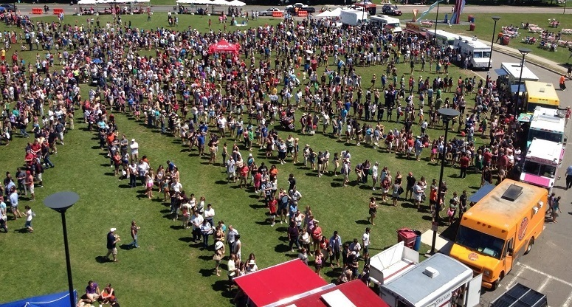
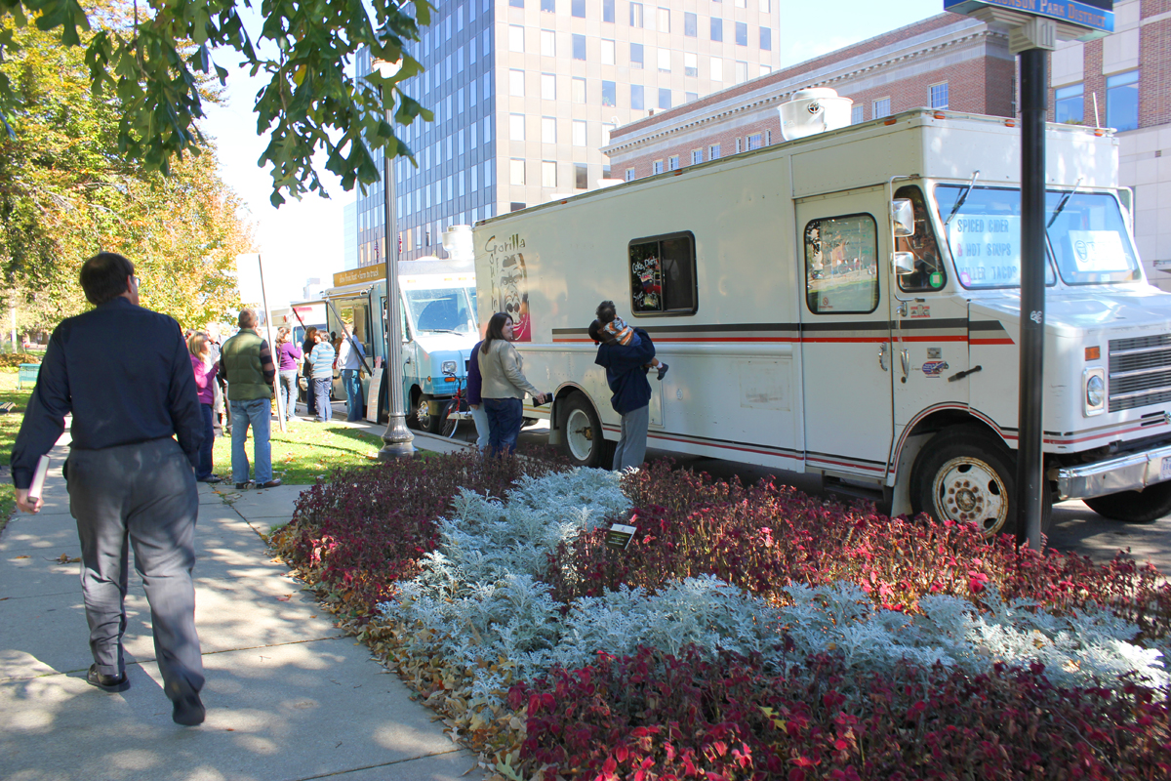
Closing
Questions and Comments?

Slide 58
THANK YOU!
Acknowledgements
IMAGES/VIDEOS
Inside Edition
KOIN channel 6 news
KEZI channel 9 news
WSOC TV 9
WTHR channel 13 news
Bacon-Bacon SFGATE: insidescoopesf.sfgate.com
Houston food Truck: mobile-cuisine.com
Miami Nights: mobile-cuisine.com
El Fuego: Foodtruckfiesta.com
Gus Hipp fire: Rockledgeprofessionalfirefighters.blogspot.com
Frites “N” Meats: CBS New York Chopper 2
Denton Market: mobile-cuisine.com
Ralphie’s Snack Bar: Phoenix Fire Department
CBS Philly channel 3 news
The Oregonian - Grant Engrav
Special Thanks to: Lt. William Smith,
Grand Rapids Fire Prevention Bureau

